Slide 1
Using Git and Github
Moving from Centralized VC to the “scary” world of Distributed VC

Slide 2
What We’re Doing
Stop using Team Foundation Version Control (TFVC)
Start using Git and Github
Just for projects going forward, starting with this one
We’ll use it as soon as it’s ready (soon!)

Slide 3
Why?
Share code with other Sage groups using Github
Take advantage of disconnected source code
Flexibility of local branching
Enhanced speed
Safety of many copies of the entire repository
Code sharing with local team members
Linus Torvalds won’t make fun of us

Slide 4
Why?
And because we’re required to by Sage.

Slide 5
First things first…
repo = repository

Slide 6
Centralized vs. Distributed
Centralized (TFS) has a single server-based database where it stores its repo. Developers have copies of the code, but not history.
Every check against history goes to the server.
Every check-out or check-in goes to the server.
Every diff goes to the server.
You get the idea.

Slide 7
Centralized vs. Distributed
Distributed (Git) has no centralized repository – everyone has a complete copy of the repo, including history.
You can still use a centralized model to some degree: keep a copy of the repo on a server (a remote repo – more on this later)
Each developer works locally, then synchronizes their completed code from their local repo with the server copy of the repo (like checking code in with a centralized system)
Each developer refreshes their local repo from the server copy on a regular basis (like daily)

Slide 8
Git vs. Github
Git is the source control tool that we will be using every day. It is the tool itself.
Github is an online service that hosts remote Git repos, and provides you with server space and tools.
Github will replace our TFS source control server/database.
We will use Git to push and pull updates to and from Github.

Slide 9
What’s the big deal?
Is Git really that different from what I’m used to in TFS?

Slide 10
What’s the big deal?
Is Git really that different from what I’m used to in TFS?
YES!

Slide 11
What’s the big deal?
Is Git really that different from what I’m used to in TFS?
YES!
And no.

Slide 12
What’s so different about it?
Snapshots, not differences. This makes Git more like a mini file system
Almost everything is local. This, plus other features, make Git operations very fast
Offline. Since things are local, most everything can be done offline. No server connection required.
Git has integrity. Everything in Git has a SHA-1 hash calculated
Command line operation. There are UIs that can sit on top of Git, but the command line comes first

Slide 13



Diagram of Git
Local Files
- Folders
- Source code
- Solution files
- etc.
Local Repos
- Folders
- Source code
- Solution files
- etc.
Pull
Push
Git Tools
Remote Repos
- Folders
- Source code
- Solution files
- etc.
Local Machine
Github

Slide 14
Basic Git Workflow
Get code to work on by cloning a remote repo to your local machine, creating a local repo
Edit and change code files locally in your project folder. No need to checkout – Git tracks changed files automatically.
Stage your changed files to the staging area
Commit changes to your local repository – like checking in files, but only to your local source control repo
Repeat until you want to update the remote repo with your code
Push code in your local repo to the remote repo

Slide 15
Remember…
Most of the time, you are working in your local repo on your local machine
Your work is not being backed up on a server
Push to the server as often as you can without interfering with the work your teammates are doing

Slide 16
Git File States
From Git’s perspective, files exist in one of five states:
Untracked
Tracked
Modified
Staged
Committed

Slide 17
Untracked Files
Git can see any file or folder in or below the project folder
If the file has not been added to your repo, it is considered Untracked
Untracked files are ignored for the most part – they show up in your Git status listing, but are otherwise left alone no matter what you do to those files

Slide 18
Tracked Files
Tracked files are those which have been added to the local repo.
Git tracks all changes to these files and keeps a history of those changes

Slide 19
Modified Files
As soon as you change a tracked file, Git knows that it has changed and lists it as a modified file
Modified files have to be staged before the changes to them are saved by Git

Slide 20
Staged Files
When you are done changing a file and want to put it into your repository, you first stage the file
This creates a snapshot of the file in its current state and puts it in the staging area
This allows you to create a subset of files that will be committed to your repository
You could continue working on the file, making edits, and the version that was staged will not contain the edits

Slide 21
Committed Files
Once files are staged, you can commit them in one step
This takes all the files that have been staged and puts them in your local repo, creating a Commit
Commits show in your Git log, and constitute the history points in your repo
This is the equivalent of checking in files with a centralized VC system, although only to your local repo

Slide 22
Getting Set Up with Git
Install the following tools on your machine:
Git (https://code.google.com/p/msysgit/downloads/list)
Github for Windows (http://windows.github.com/)
KDiff3 (http://sourceforge.net/projects/kdiff3/files/kdiff3/)
Notepad++ (optional) (http://notepad-plus-plus.org/)
Or get them all here: \\vahfp02\DevData\data\tony\Git Training
Hands-on

Slide 23
Git Shell
You’ll need a command shell in which you will issue all your Git commands
Use:
Git Shell (comes with Git for Windows)
Git Bash (comes with Git)
Powershell (comes with Windows)
Under NO CIRCUMSTANCES should you use the standard Windows command prompt (cmd.exe)!
We’re going to use Git Shell for now

Slide 24
Creating Your First Repo
Fire up the Git Shell
Switch to the folder where your project will be or is located
Issue your first Git command, to create the empty repo:
git init
This creates a hidden folder called .git that will contain all your repo information
Hands-on

Slide 25
Configuring Git
Set your user name:
git config --global user.name “rajsekharvarma”
Set your email:
git config --global user.email sekharvarma.sr@sonata-software.comSet your default editor:
git config --global core.editor <editor>
Set your default merge tool:
git config --global merge.tool <merge tool>
Set the CR/LF handling:
git config --global core.autocrlf false
Hands-on

Slide 26
Configuring Git - optional
Create aliases as shortcuts for commands.
Launch your editor:
git config --global alias.np !notepad++.exe
Useful shortcuts:
git config --global alias.st “status”
git config --global alias.sf “stage”
git config --global alias.co “checkout”
git config --global alias.cm “commit”
git config --global alias.gl “log --graph --oneline --decorate”
Hands-on

Slide 27
Getting a Repo from a Remote
We’ll start by getting some code to work with
Example project is posted in Github
Steps:
Clone the repository from Github
Compile the project to make sure it builds
Commit the code in order to update your local repo
Verify that all is well
Hands-on

Slide 28
Clone the Example Project
Fire up Git Shell
Change to your project root folder
Issue the following Git command:
git clone https://github.com/tirith63/GitDemo.git
This will contact Github and download the latest code
Hands-on

Slide 29
Code Tour
Example code is a dummy class library intended to be sold as a product
Take a quick look at the files involved
Build the code
Hands-on

Slide 30
Ignoring Files
When you add or stage files, you can add entire folders at once, including all contained files in all subfolders
There are plenty of files you don’t want to add
The .gitignore file lists the files you want Git to ignore
Goes in your project root folder
Take a look at it
Hands-on

Slide 31
Making your first edit
Open the project
Open the Aircraft.cs file
Add the following property to the class:
public bool Winglets { get; set; }
Save and build
Hands-on

Slide 32
Making your first edit
Now issue the following command:
git status
It will show we have a modified file:
Aircraft.cs
Hands-on

Slide 33
Making your first edit
Take a look at the output
Files show in red, and the output says the files are NOT staged for commit
Output also shows some helpful commands you might want to use, such as how to stage the files or how to discard the modifications
We’ll go over the very informative command prompt later

Slide 34
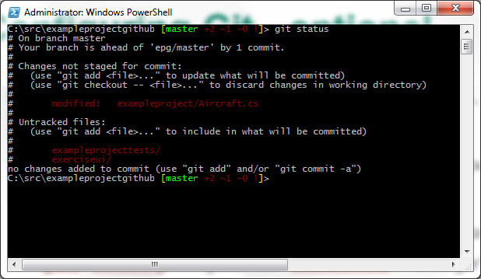
Git Commands You’ll Love
Find out the current status of files:
git status

Slide 35
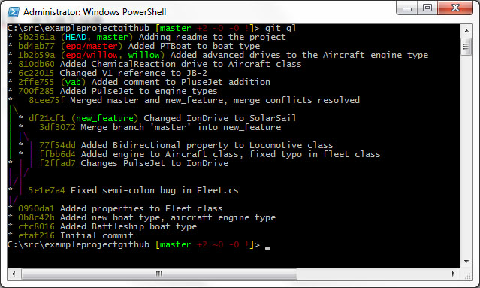
Git Commands You’ll Love
Show the repo’s history of commits:
git log

Slide 36
Creating a new file to add
We still have unstaged modified files
Let’s add a new file: create a text file called readme.txt
Most Git repos have a readme to tell you about the project
Once that’s done, display the status again
It shows the modified file not yet staged, and our new file, listed as Untracked
Add the new file so that Git knows to track it:
git add readme.txt
Show the status again, and our readme has moved from Untracked to New and Staged
Hands-on

Slide 37
Stage modified files
If you have modified files that are done and you’re ready to put them in the repo, you first stage them
This gets them ready to commit
Change to the project folder and issue this command:
git add Aircraft.cs
Note that Git commands are case-sensitive
Show the status again. You’ll see both files are green, and listed as “Changes to be committed”
Hands-on

Slide 38
Your first Commit
We have two modified files and one new one, all ready to be committed to our repo
This is the equivalent of TFS’s check-in command, although the files are being committed to our local repo, not a server
Everything is done, tested, and we’re happy with it, so it’s time to put them in the repo. Use this command:
git commit –m “Removing unused projects and adding Winglets property to Aircraft class”
Git will report results
Hands-on

Slide 39
Post-commit
Show your git status once more. It should show a clean working directory and nothing to commit
Run this command to see your commit information:
git log –3
This will show the 3 most recent commits. You’re interested in the first one.
Use any number you like
Hands-on

Slide 40
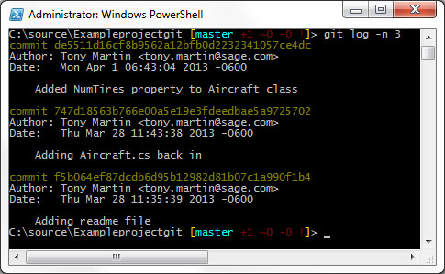
The Git Log Output
Commit SHA-1 hash code
Person who made the commit
Commit date and time
Commit comment (important!)

Slide 41
Snapshot-oriented
Git saves snapshots, not file differences
When you commit, you’re saving complete copies of everything that is currently staged
A single commit could represent any number of files changed
You still might need to know what happened in a single file, and who did it…

Slide 42
Activity in a single file
Git does provide a command to see what happened in a single file over time
Run the following command to have a look:
git blame <file>
This will show who was responsible for each change in each line
Can also use git annotate for a slightly different format
Hands-on

Slide 43
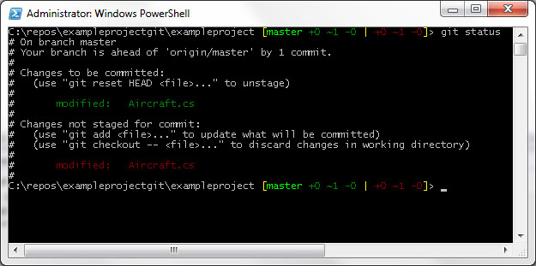
File in two states
It is possible to have the same file in two states:
Modified
Staged
Happens when you stage a file for commit, but make more changes to it before the commit

Slide 44
File in two states
Use git diff to see the differences in the two files
How do you resolve this? Two options:
Do a commit
This would commit the staged version and leave the unstaged modified version
Do this if you want to track the two changes as separate commits
Add the file again
This would replace the committed snapshot with the modified un-staged version
Do this if you just want the latest version committed and tracked

Slide 45
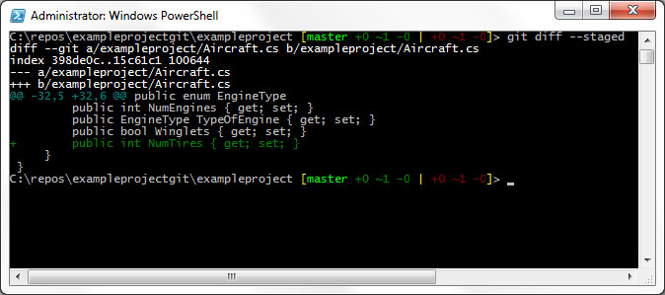
What will I be committing?
You can see the exact changes made in each staged file that will be committed:
git diff --staged

Slide 46
Un-staging
Stage a file you changed your mind about? You can un-stage it
git reset HEAD <file>
You will lose the changes in the staged snapshot, but not your corresponding local file
Hands-on

Slide 47
In a hurry?
Normally, you stage files and then commit them
Don’t always need the staging step, and just want to commit them as soon as you are done editing and testing
You can go straight from Unstaged to Committed in one commit command using the –a parameter:
git commit –a –m “<commit comment>”
Be careful with it – you don’t get the safety of the staging area
Hands-on

Slide 48
Deleting files
There may be files you don’t want to track any more
Delete them from your local repo – AND YOUR LOCAL MACHINE – using this command:
git rm <file>
Want to delete the file from your repo but leave it on your local machine? Use:
git rm --cached <file>
The rm command deletes permanently – use with extreme caution
Hands-on

Slide 49
More about git log
Using git log gives you basic information, but there are lots of options:
See the changes on each commit:
git log –p
See some abbreviated stats for each commit:
git log --stat
See the last 5 days of commits:
git log --since=5.days
Abbreviated listing with branches and other info:
git log --graph --oneline --decorate
Hands-on

Slide 50
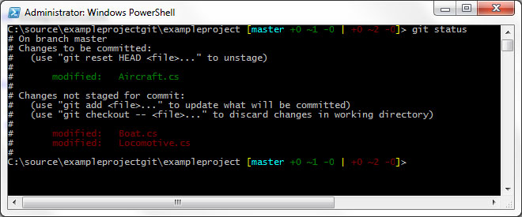
The Git Shell Prompt
Looks like this (you’ve seen it, now take a look):

Slide 51
The Git Shell Prompt
Format: [{HEAD-name} +A ~B -C !D | +E ~F -G !H]
HEAD-name = the current branch. Color coded:
Cyan: This branch matches its remote (if a tracked branch)
Green: This branch is ahead of its remote
Red: This branch is behind its remote
Yellow: This branch is both behind and ahead of its remote
ABCD (in green) represents the local repository; EFGH (in red) represents the working directory.
+ : Added files (local repository) or files that could be added (untracked files) (local directory)
~ : Modified files
- : Deleted files
! : Files in conflict

Slide 52
Git Shell Prompt
The following prompt:
[master +1 ~0 -0 | +2 ~1 -0 !]>
Matches the following Git status:
# On branch master
# Changes to be committed:
# (use "git reset HEAD <file>..." to unstage)
#
# new file: readme.txt
#
# Changes not staged for commit:
# (use "git add <file>..." to update what will be committed)
# (use "git checkout -- <file>..." to discard changes in working directory)
#
# modified: readme.txt
#
# Untracked files:
# (use "git add <file>..." to include in what will be committed)
#
# exampleprojecttests/
# exerciseui/
Local repo:
1 file has been added
0 modified filed
0 deleted files
Local directory:
2 files have been added
1 file has been modified
0 files have been deleted

Slide 53
Gitting help ☺
Get help on any git command:
git <command> --help
This will show the official help pages in your web browser
Sometimes, often, they are difficult to interpret
The Git Pro bit can be a lot more help:
http://git-scm.com/book
Lots of good web sites out there, too

Slide 54
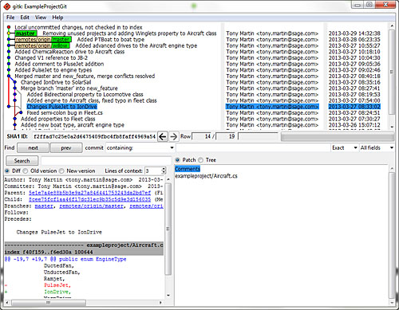
Git’s visual commit tool
Itching for some UI at this point?
Use this complex command to see commits visually:
gitk
Hands-on

Slide 55
Changing your last commit
To edit the files or changes you’ve put into a LOCAL commit, amend the commit
Make whatever local changes you want to files
Stage them
Use the commit command with --amend
git add <file> git commit --amend -m “<commit comment>”
Use to simply modify the commit comment, or modify the files that were added or updated
Do NOT use amend on commits that have been pushed to a remote! You will mess up others doing work based on it
Hands-on

Slide 56
Discarding local changes
Easy to discard local working directory changes and revert to the last version committed to your local repo:
git checkout -- <file>
Use with caution – your local changes will be discarded and are not recoverable
Hands-on

Slide 57
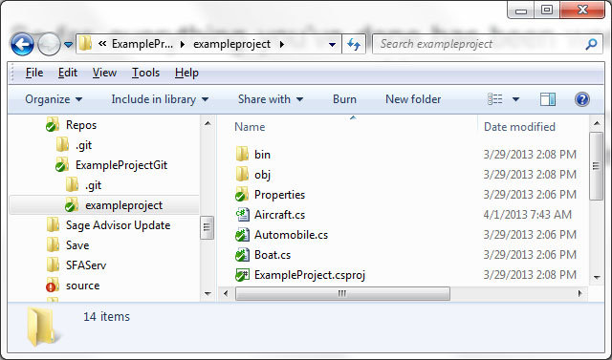
Remote Repos
So far, everything you’ve done has been working with a local repo on your own machine
Remote repos, including those stored in Github, can act like your server-side copy. We’ll be doing this:
Local Repo
Remote
Repo
(fork)
Remote
Repo
Pull
Push
Used by Developers
Used for Releases

Slide 58
Remote Repos
Remote repos are exactly the same as your local repos, but may be more or less up to date than your local
They contain the exact same information as your local repo
We’ll be using a couple of remote repos, as shown, as our official copies of the source code and other files
You can also create your own remote repos on your own account (such as for your own backups, but make sure they’re secure)

Slide 59
Remote Repos
Work daily on your local repo
In the morning, pull the latest code from the remote repo
This will get your local repo up to date with the latest code from your team members
Will prevent too many merge conflicts when you get the latest code if you do it frequently
When you are done with code, and it’s committed to your local repo, push your local repo to the remote
We’ll talk about this in detail

Slide 60
Adding Remotes
Before you can use Git with a remote repo, you have to let Git know it exists:
git remote add <short name> <remote URL>
You can also show a list of all your remotes:
git remote [-v]
When you clone a repo, as we have, you get a default remote added called origin
Hands-on

Slide 61
Naming your remote
The remote called origin that gets created for you by the clone operation can (and probably should) be renamed
Use the remote rename command:
git remote[-v]
git remote rename <old name> <new name>

Slide 62
Updating your local repo
Two ways to do this: fetch/merge and pull
Fetch command will get the latest from the remote repo and update your local repo. Your local code will not be updated to match until you do a merge.
Pull does both in one step: gets the latest code from the remote, updates your local repo, and then merges it with your local code
Commands:
git fetch <remote repo> (ex: git fetch fs)
git merge <remote branch> (ex: git merge fs/master)

Slide 63
Updating the remote repo
At some point, you’ll be ready to send all you latest code to the remote repo
Make sure everything is done, compiles, and has been unit tested
Use the git push command:
git push <remote repo> <branch>
Example: git push fs master

Slide 64
When Pushing doesn’t work
Sometimes a push will be rejected because someone else got there first
Recovery procedure:
Refresh your local repo from the remote (git fetch <remote repo>)
Merge changes with your local code (git merge <remote branch>)
Rebuild all code
Run unit tests (all must pass or you cannot push to the server)
Commit your changes locally
Push your changes up to the server again

Slide 65
Updating your local repo
Let’s try the push and fetch/merge process – will be used most often
Simple example: Hello, Git
Start from scratch
Show creation of the remote repo, pushing updates, and getting latest code with fetch/merge
Hands-on

Slide 66
Tags
Tags are just like version labels
Add them to any commit
Annotated tags are tracked as full git objects with lots of information
Lightweight tags are just a local label on a specific commit
Create an annotated tag:
git tag -a <tag name> -m “<tag comment>”
Tagging after the fact:
git tag -a <tag name> -m “<tag comment>” <sha-1 of commit>
Hands-on

Slide 67
Tags
If you want to share your tags on the remote repo, use the --tags parameter on your push command:
git push <remote name> --tags

Slide 68
Branching with Git
Why is branching important?
Isn’t that something that only CM types worry about?
Git branching is fast and lightweight
You can use it multiple times a day
Might change the way you code
Why would you want to create your own branches?

Slide 69
Branching with Git
Example scenario:
You start new feature, but before any coding, you create a new branch off your master and start coding on the new branch
Your new branch is called “new_feature”
After working on your branch for a couple days, the Scrum Master comes to you and says priorities have changed – you need to fix a bug on the master branch
You *don’t* want to include your changes – they aren’t finished
You go back to your master where you started the new feature, and create a new branch called “bug_fix”
Fix the bug, merge the bug_fix branch code back into the master branch, and push to the remote
Continue working on your feature on the new_feature branch
Merge new_feature into the master when you’re done and push to remote

Slide 70
Branching basics
A branch is essentially a pointer to a commit
The default branch is called master
Without creating a branch, you’re still working on the default master branch
You can see the master on remote repos, too, in Github
There’s a special pointer called HEAD that always points to your current branch

Slide 71
Branching example
Say we start with a project in progress that has two commits so far. The commit chain looks like this:
HEAD
master
Commit #1
3f45a1
Commit #2
9b213c

Slide 72
Branching example
Now we need to create a branch called new_feature. Use the command:
git branch new_feature
HEAD
master
Commit #1
3f45a1
Commit #2
9b213c
new_feature

Slide 73
Branching example
You still have to switch to the new branch now the you’ve created it. Use the checkout command:
git checkout new_feature
master
Commit #1
3f45a1
Commit #2
9b213c
new_feature
Note: Git’s checkout command
has NOTHING to do with checking
out files! This isn’t TFS!
HEAD

Slide 74
Branching example
Now make some changes and commit them on the new branch. Our situation now looks like this:
master
Commit #1
3f45a1
Commit #2
9b213c
Commit #3
724ac1
new_feature
HEAD

Slide 75
Branching example
Now we need to go back to the master branch and make changes. Switch back to it, and this is what happens:
git checkout master
HEAD
master
Commit #1
3f45a1
Commit #2
9b213c
Commit #3
724ac1
new_feature

Slide 76
Branching example
Make a few changes on the master branch and commit. We now look like this:
HEAD
master
Commit #4
22a87d
Commit #1
3f45a1
Commit #2
9b213c
Commit #3
724ac1
new_feature

Slide 77
Branching example
We’re done with our fix on the master branch. We commit it locally, then push it to the remote repo.
After that, we go back to working on the new_feature branch
Do a checkout on the new_feature branch

Slide 78
Branching example
We do one more set of changes on the new_feature branch:
master
Commit #4
22a87d
Commit #1
3f45a1
Commit #2
9b213c
Commit #3
724ac1
Commit #5
f5409a
new_feature
HEAD

Slide 79
Branching example
We’re done with new_feature, so we commit it. Now we need to merge it back into the master:
git checkout master
git merge new_feature
HEAD
master
Commit #4
22a87d
Commit #6
22a87d
Commit #1
3f45a1
Commit #2
9b213c
Commit #3
724ac1
Commit #5
f5409a
new_feature

Slide 80
Branching example
Now we continue forward working on master. Example with one more commit:
HEAD
master
Commit #4
22a87d
Commit #6
22a87d
Commit #7
361fc7
Commit #1
3f45a1
Commit #2
9b213c
Commit #3
724ac1
Commit #5
f5409a
new_feature

Slide 81
Branching Commands
Create a new branch:
git branch <branch name>
Switch to another branch:
git checkout <branch name>
Create *and* switch to a new branch:
git checkout -b <new branch name>
Delete a branch:
git branch -d <branch name>
Force-delete a branch that has unmerged changes
git branch -D <branch name>

Slide 82
Branching Commands
See differences between branches:
git diff <branch 1> <branch 2>
See all my branches:
git branch -v
Hands-on

Slide 83
Merging
Once you create a branch and work on it, you will eventually need to merge the changes back into master
Basic merge command:
git checkout <branch to merge into>
git merge <branch to merge from>
Example: Merge the new_feature banch back into master
git checkout master
git merge new_feature
See all branches that have unmerged changes:
git branch --no-merged

Slide 84
Merge Conflicts
Sometimes merges have conflicts, either as a result of branching, or from pushing or pulling from a remote repo
If a merge conflict occurs, Git does NOT COMMIT anything, but leaves the changes staged
Should launch the merge tool automatically
Once merge is complete, look at status and try to commit again
Can also launch merge tool manually:
git mergetool
Do an example with KDiff3
Hands-on

Slide 85
Branching and Merging
Do NOT switch branches when you have un-committed changes on the current branch
Either commit or stash your current changes before you switch branches
If there is a conflict in branch merging, Git does not commit anything, but leaves all changes staged
When branch merge conflicts occur, Git leaves a file behind the shows the conflicts, called <filename>.orig. Once the conflicts are all resolved, you can delete the file

Slide 86
Github
Take a tour of the place:
Repos
Files
Commits
Branches
Pull requests

Slide 87
Rebasing
Rebasing is a merge that cleans up branch history
If you merge two branches, you still have the branch history
If you rebase instead, your branch history will be squashed down into a linear history
You can use it to effectively rewrite commit history
Would recommend not using it for now
Look into it some more if you are interested
Note: If you are rebasing, do NOT rebase anything you’ve committed and pushed to a remote!

Slide 88
Stashing
Very much like TFS’s shelving
Put your work away while you do something else.
Does not create a new branch
Removes changes you’ve made to your local code since the last commit on the branch on which you’re working
Can create multiple stashes
Can also convert a stash into a branch

Slide 89
Stashing
Create a new stash:
git stash
See my stashes:
git stash list
Get code out of a stash and reapply it to your local code:
git stash apply [stash ID]
Convert a stash into a branch:
git stash branch <new branch name>
Hands-on

Slide 90
Useful Commands
See all the files being tracked in my repo:
git ls-tree --full-tree -r HEAD
Get an earlier version of a file:
git diff <sha-1 of earlier version commit> <file>
git reset <sha-1 of earlier version commit> <file>
See the details of the most recent commit:
git show
See the details of any specific commit:
git show <sha-1 of commit>

